Slide 1
Validate Subsequence
2023/03/04

Slide 2
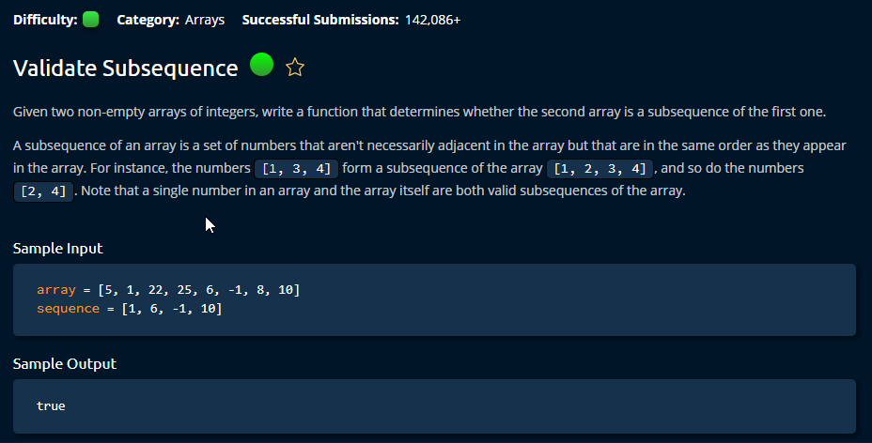

Slide 3
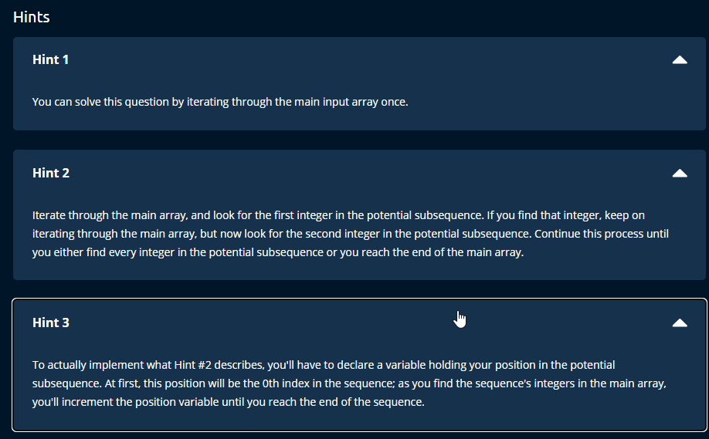

Slide 4
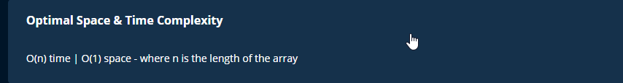

Slide 5
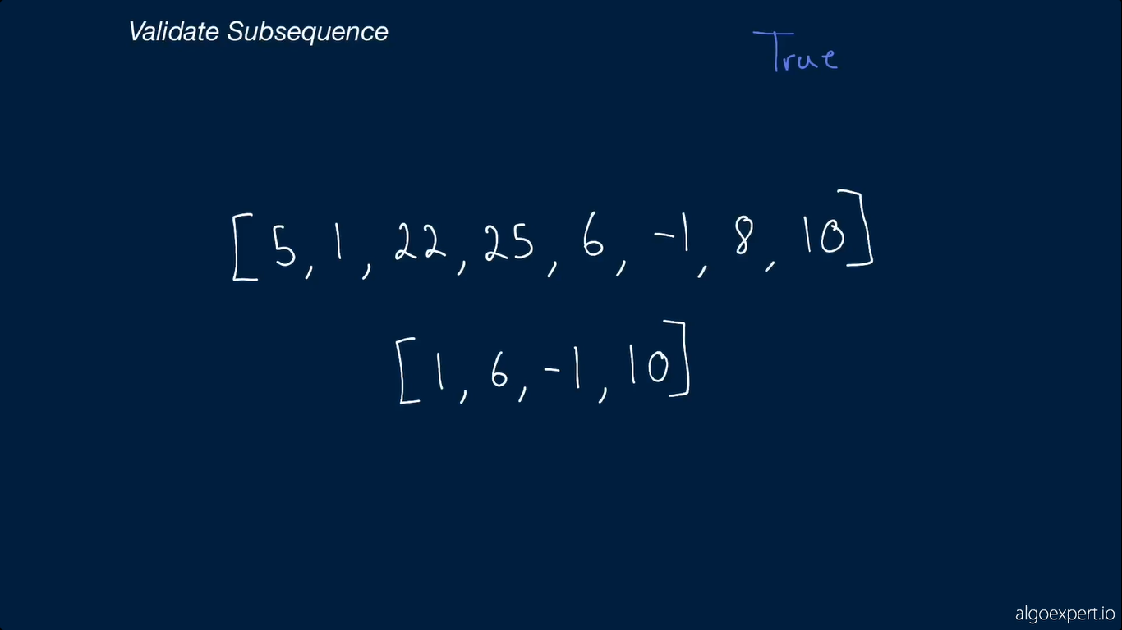

Slide 6


Slide 7
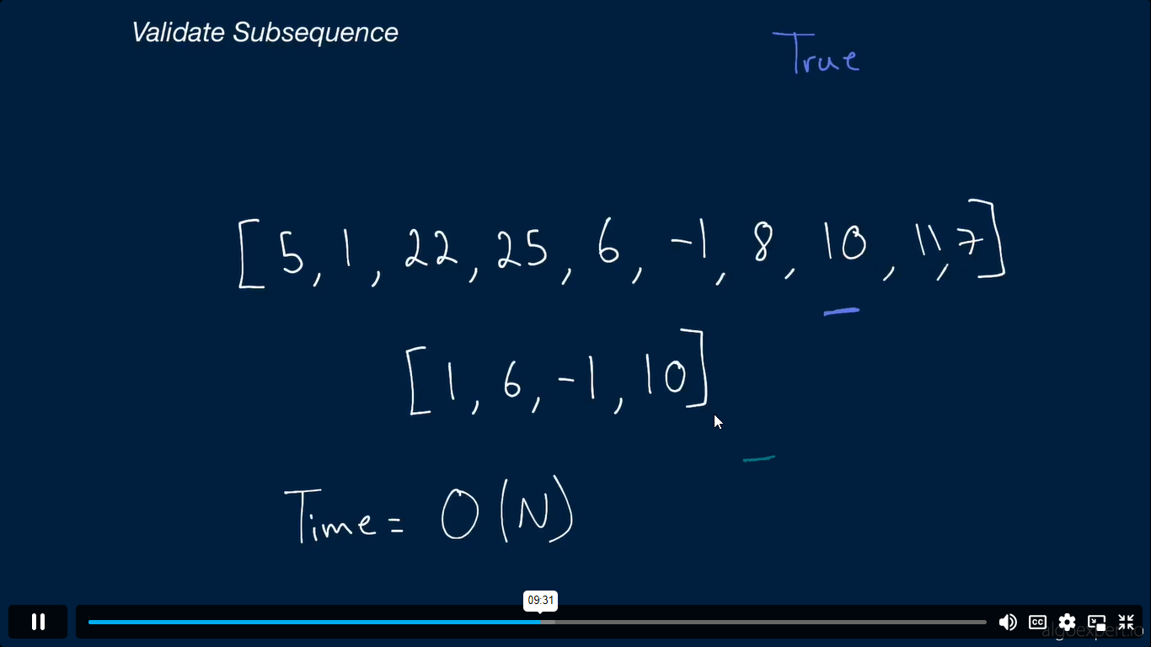

Slide 8
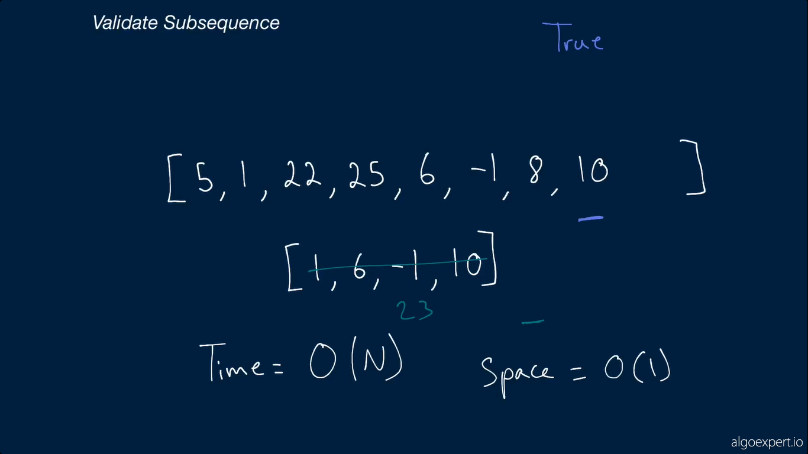

Slide 9
Notes
Time complexity: O(n), where n is the length of the array.
Space complexity: O(1), since we only use a constant amount of additional space to store the arrayIdx and sequenceIdx variables. We don't use any additional data structures or create any new arrays.

